Slide 1
Lexis diagram and system of demographic indicators
16. 11. 2022
Bety Ukolova – ukolovae@natur.cuni.cz

Slide 2
Lexis diagram
a. Deaths at completed age 2 years, from birth cohort 1989
b. Deaths at reached age 2 years from birth cohort 1989
c. Death at completed age 2 years in 1991.
d. Deaths at completed age 11 years during 2002–2003
e. Deaths at reached age 11 years during 2002 and 2003
f. Deaths at completed age 2 years in 1991 from birth cohort 1989
g. Deaths at completed age 11 and 12 years in 2002–2003
h. Persons living at exact age 36 in years 2002–2003
i. Persons living at completed age 15–17 at 1. 7. 1998.

Slide 3
Demographic indicators (I)
Absolute measures
Components of population change (P_{t+1} = P_{t} + N_{t} – D_{t} + I_{t} – E_{t})
Relative measures
Relative frequencies, proportions (extensive)
Rates and probabilities (intensive)
Ratios
Indices

Slide 4
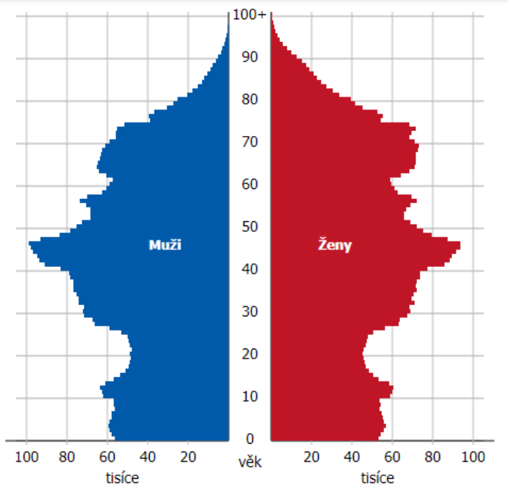
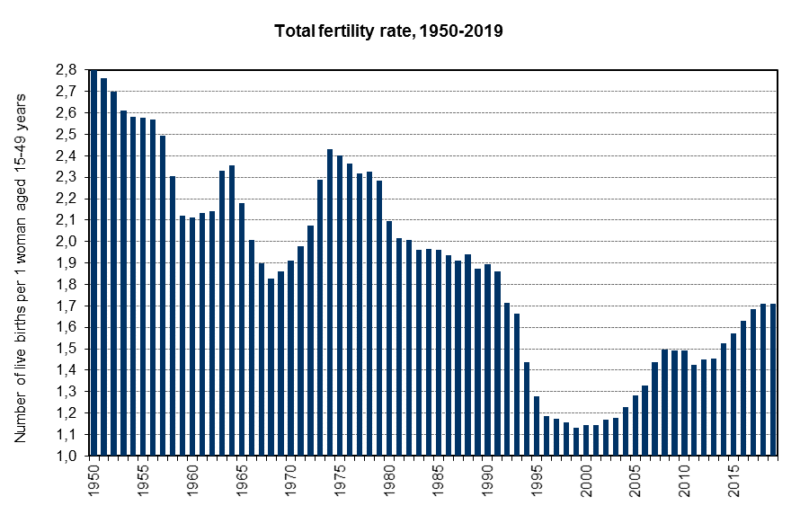
Demographic indicators (I) – drawbacks
Drawbacks examples: Analysing fertility with absolute numbers, sever covid and vaccination thru relative measures, age specific index of abortion
Age structure of Czechia at 1. 1. 2021
Total fertility rate (average number of children per woman), Czechia, 1950–2019

Slide 5
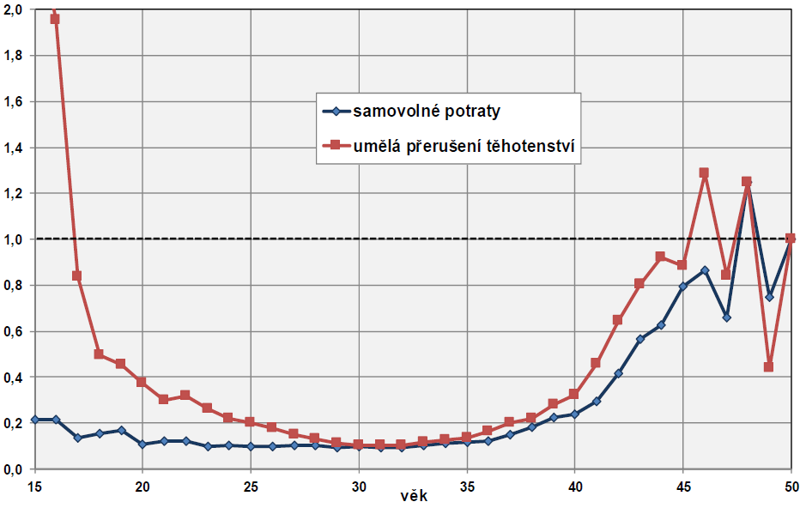
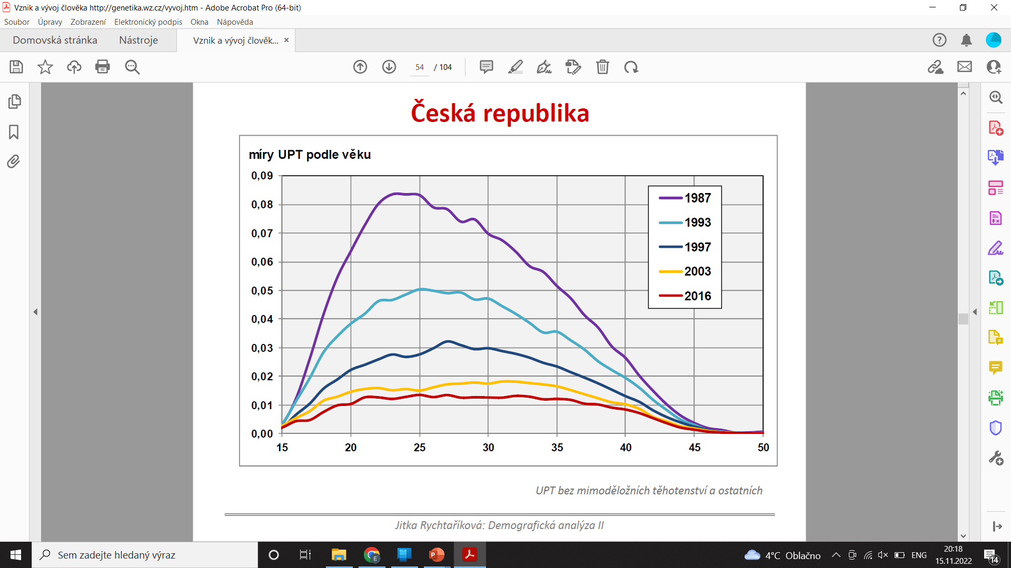
Demographic indicators (I) – drawbacks
Drawbacks examples: Analysing fertility with absolute numbers, sever covid and vaccination thru relative measures, age specific index of abortion
Age specific index of abortion, Czechia, 2016
Age specific abortion rates, Czechia, 2016

Slide 6
Demographic indicators (II)
Crude
Crude death rate, crude birth rate…
General
General fertility rate…
Analytical (synthetic)
Total fertility rate, life expectancy…
Specific
Age specific death rate…
Differential
Age specific death rates by educational attainment, by parity…
Standardized, adjusted, corrected
Standardized death rate…

Slide 7
Demographic indicators (III)
Provisional
Final
Revised
Corrected

Slide 8


$$\frac{numerator}{denominator}$$
Rates and probabilities
= Two major categories of measures used by demographers.
$$rates= \frac{Number of occurences of events}{Exposure}$$
Exposure ~ Average size of a population during a given period ~ Number of person years exposure to risk ~ Mid-year population at risk
$$probabilities= \frac{Number of occurences of events}{Population at risk at the beginning of the interval}$$
$Population at risk at the beginning of the interval$ ~ Population on 1st of January
Age specific mortality rate is denoted as u_{x} or m_{x}. Age specific probability is denoted as q_{x}. From that, these measures are sometimes called m-rates and q-rates, even tough both of them are not rates.

Slide 9
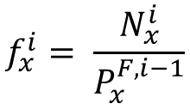
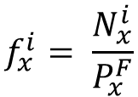
Age specific mortality rates
Events are either evitable (avoidable; birth of a child) or inevitable (unavoidable; death). Events can also be repeatable (birth of a child) or unrepeatable (death). These differences have implication for computations of rates and probabilities.
If the events are avoidable, we distinguish between
Rates of the first type (conditional rates, occurrence-exposure rates)
Rates of the second type (unconditional rates, reduced rates)
$$f_{x}^{i}= \frac{N_{x}^{i}}{P_{x}^{F}}$$
Age specific unconditional fertility rate:
i birth order of a child
F female
x age
N number of birth
P population exposure
$$f_{x}^{i}= \frac{N_{x}^{i}}{P_{x}^{F, i−1}}$$
Age specific conditional fertility rate:

Slide 10
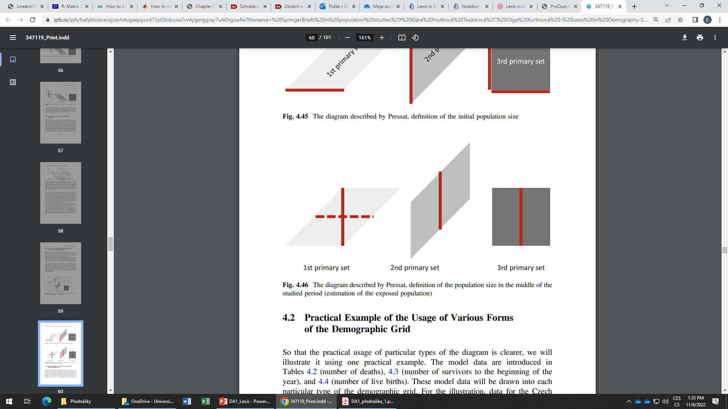
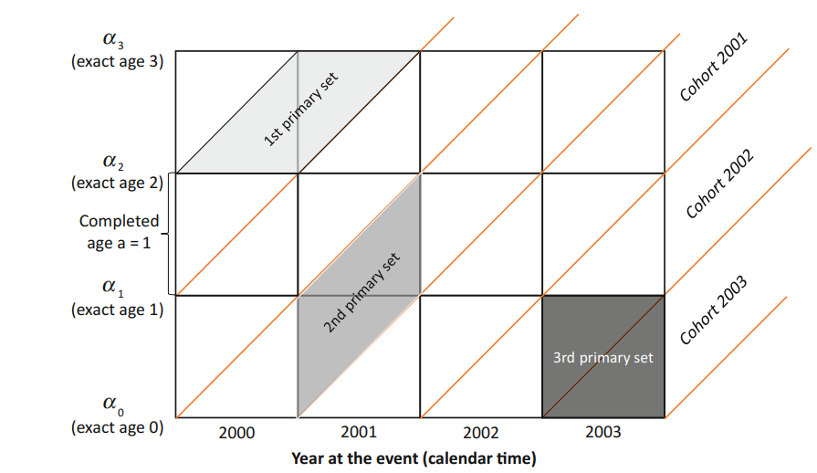
Age specific mortality rates
Mortality rates can also be distinguished according to the sets of events they belong to.
1st primary sets
Rates by horizontal
parallelograms
Rates by age
completed and cohort
To calculate the rates, we need to sum right elementary sets and consequently, estimate population exposure.
2nd primary sets
Rates by vertical
parallelograms
Rates by age reached
and a cohort
3rd primary sets
Rates by squares
Rates by age completed
and a year (period)

Slide 11
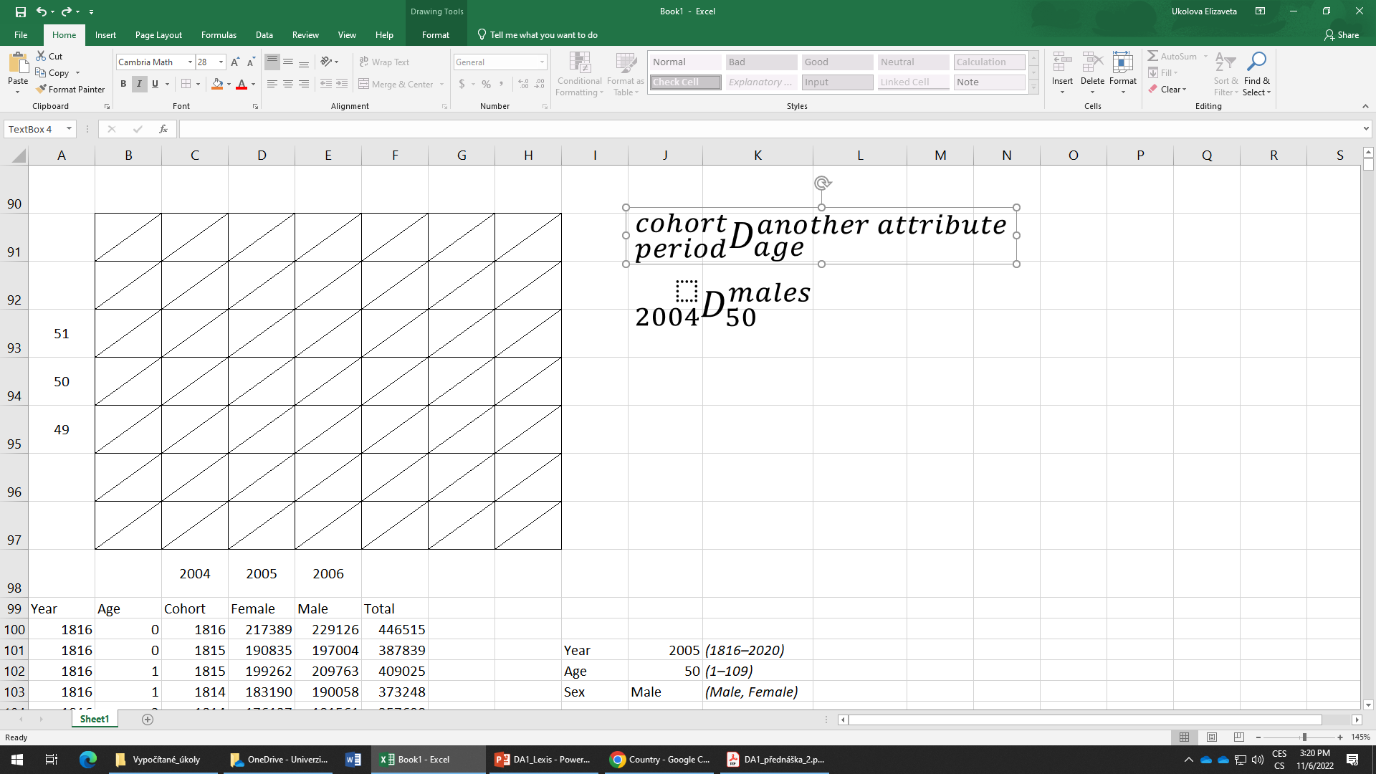
Exercise 2
Estimate a., b., c., d. and e.
22
b.
100
105
e.
21
10 000
10 500
120
115
a.
d.
110
100
20
c.
90
95
2000
2001
2002
2003

Slide 12
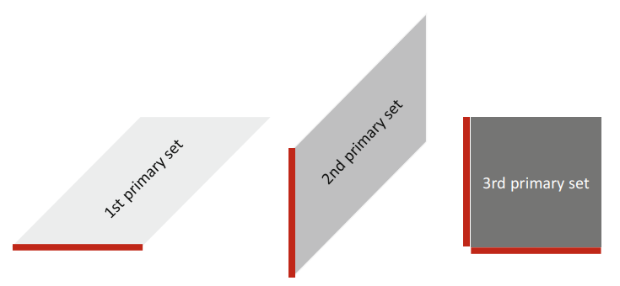
Age specific probabilities of death
Age specific probabilities of death can be computed either directly or indirectly.
The indirect estimation relies on derivation of probabilities from mortality rates.
The direct estimation relies in direct computations from data (dividing events by population at the beginning of the interval, in other words by the initial population).
q_{x}
Indirect method
Linear method
Exponential method
Direct method
Today we will only estimate the probabilities with direct method, however, this does not mean, that this approach is more or less important than the other one.
Initial population size

Slide 13
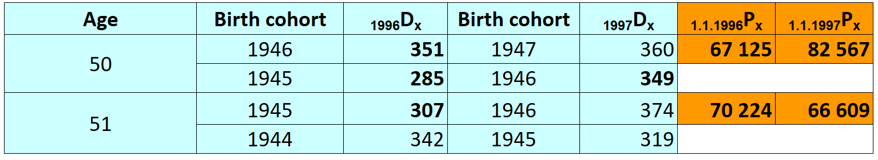
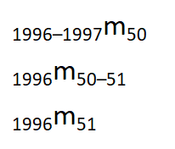
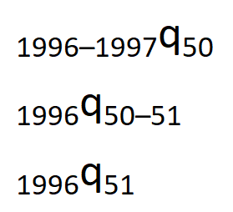



Direct calculation of rates and probabilities: example
Draw following data to Lexis diagram:
$${{}_{period}^{cohort}D}_{age}^{\begin{aligned}another \\ attribute\end{aligned}}$$
Calculate age specific mortality rates a probabilities of dying:
Can be directly estimated from Lexis diagram
Remember (in 3rd sets of events)
$${{}_{t}^{c−c+1}q}_{x}=\left(q_{1}+q_{2}\right)−\left(q_{1}×q_{2}\right)$$
Can be directly estimated from Lexis diagram and a formulae has to be applied
$$q_{1}=\frac{Deaths in upper elementary set of events}{Population on 1.1. at given period}$$
$$q_{2}=\frac{Deaths in lower elementary set of events}{Population at given exact age}$$

Slide 14
Homework
Submit to Moodle 2 Exercise 1 (Lexis diagram)
Try to make the computations from previous slide and submit in Excel to Moodle 2.

